Slide 1
Chapter 5
Computer Security

Slide 2
Outline
How do you protect your information resources?
What are the primary threats to an information system?
What primary options are used to provide computer security?
What non-computer-based tools can be used to provide additional security?
How do you protect data when unknown people might be able to find it or intercept it? What additional benefits can be provided by encryption?
How do you prove the allegations in a computer crime?
What special security problems arise in e-commerce?

Slide 3
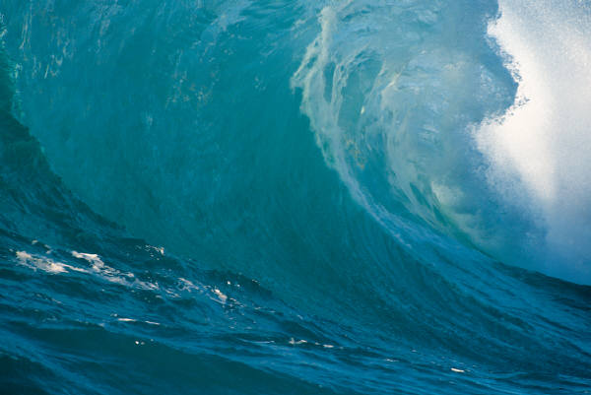
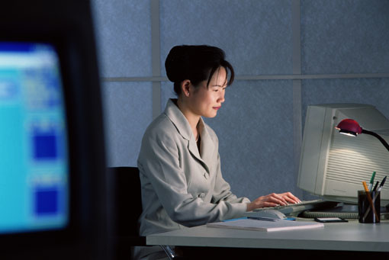
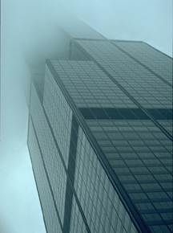
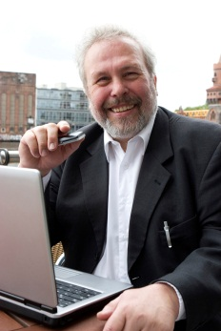
Computer Security
Server Attacks
+ Physical Dangers
The Internet
Data interception
+ external attackers
Monitoring/
Spyware
Internal + Privacy

Slide 4
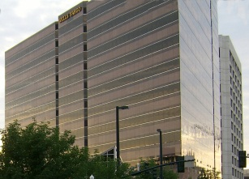
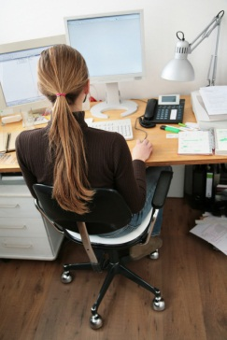
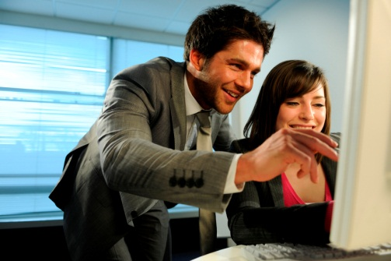
Threats to Information
Accidents & Disasters
Employees & Consultants
Business Partnerships
Outside Attackers
Viruses & Spyware
Direct attacks & Scripts
Links to
business
partners
Virus hiding in e-mail or Web site.
Employees & Consultants
Outside
hackers

Slide 5
Security Categories
Physical attack & disasters
Backup--off-site
Physical facilities
Cold/Shell site
Hot site
Disaster tests
Personal computers
Continuous backup
Behavioral
Users give away passwords
Users can make mistakes
Employees can go bad
Logical
Unauthorized disclosure
Unauthorized modification
Unauthorized withholding, Denial of Service
Confidentiality, Integrity, Accessibility (CIA)

Slide 6
Horror Stories
Security Pacific--Oct. 1978
Stanley Mark Rifkin
Electronic Funds Transfer
$10.2 million
Switzerland
Soviet Diamonds
Came back to U.S.
Hacker/youngster: Seattle
Physically stole some computers and was arrested
Sentenced to prison, scheduled to begin in 2 months
Decides to hack the computer system and change sentence to probation
Hacks Boeing computers to launch attack on court house
Mistakenly attacks Federal court instead of State court
Gets caught again, causes $75,000 damages at Boeing
Robert Morris--1989
Graduate Student
Unix “Worm”
Internet--tied up for 3 days
Clifford Stoll--1989
The Cuckoo’s Egg
Berkeley Labs
Unix--account not balance
Monitor, false information
Track to East German spy: Marcus Hess
Old Techniques
Salami slice
Bank deposit slips
Trojan Horse
Virus

Slide 7
More Horror Stories
TJ Max (TJX) 2007
A hacker gained access to the retailer’s transaction system and stole credit card data on millions of customers.
The hacker gained access to unencrypted card data.
The hacker most likely also had obtained the decryption key.
TJX was sued by dozens of banks for the costs incurred in replacing the stolen cards.
(2011) Hackers were arrested and sentenced. One (Albert Gonzalez) had been working as a “consultant” to federal law enforcement.
Alaska State Fund 2007
Technician accidentally deleted Alaska oil-revenue dividend data file.
And deleted all backups.
70 people worked overtime for 6 weeks to re-enter the data at a cost of $220,000.
Terry Childs, San Francisco Network Engineer
In 2008 refused to tell anyone the administrative passwords for the city network
The networks remained running, but could not be monitored or altered.
He eventually gave them to the Mayor, but was convicted.
NY Times
Rolling Stones
Govt Tech

Slide 8
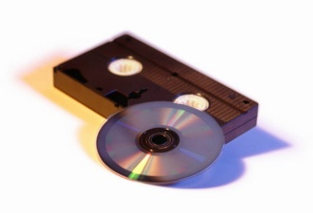
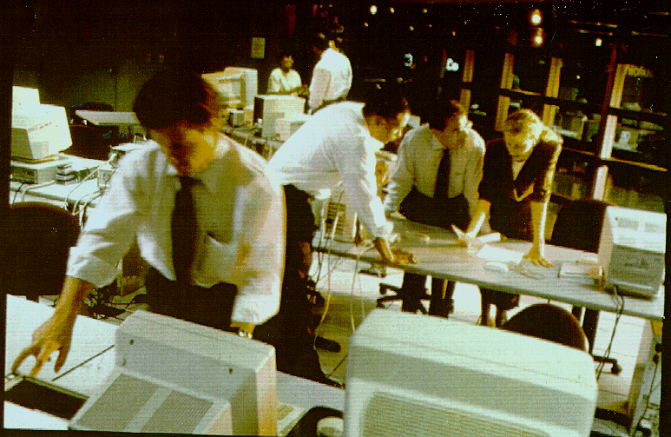
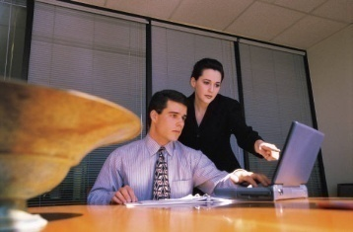
Disaster Planning (older)
Backup data
Recovery facility
A detailed plan
Test the plan
Backup/Safe storage
Recovery Facility
MIS Employees
Network
Business/Operations

Slide 9
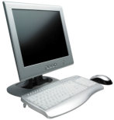
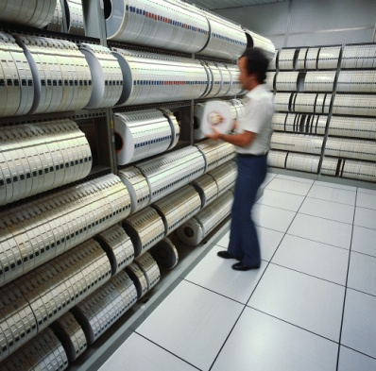

Data Backup (in-house/old style)
Power company
Use the network to back up PC data.
Use duplicate mirrored servers for extreme reliability.
UPS
Frequent backups enable you to recover from disasters and mistakes.
Diesel generator
Offsite backups are critical.

Slide 10
Disaster Planning (continuous)
How long can company survive without computers?
Backup is critical
Offsite backup is critical
Levels
RAID (multiple drives)
Real time replication
Scheduled backups and versions
Not just data but processing
Offsite, duplicate facilities
Cloud computing
Still challenges with personal computer data

Slide 11

Continuous Backup
Secure Internet connection
Storage area network with redundancy and RAID
Off-site or cloud computing processing and data
Server cluster with built-in redundancy
Use both sites continuously or switch DNS entries to transfer users in a disaster.
Users connect to the servers

Slide 12
Threats to Users
Attacker takes over computer
Virus/Trojan
Phishing
Unpatched computer/known holes
Intercepted wireless data
Bad outcomes
Lost passwords, impersonation, lost money
Stolen credit cards, lost money
Zombie machine, attacks others
Commits crimes blamed on you

Slide 13
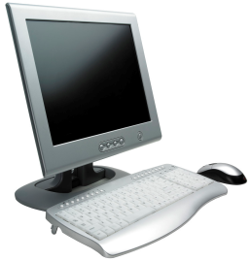
Virus/Trojan Horse
From: afriend
To: victim
Message: Open the attachment for some excitement.
2
3
1
1. User opens an attached program that contains hidden virus
2. Virus copies itself into other programs on the computer
3. Virus spreads to other files and other computers.
Attachment
01 23 05 06 77 03
3A 7F 3C 5D 83 94
19 2C 2E A2 87 62
02 8E FA EA 12 79
54 29 3F 4F 73 9F
Virus code

Slide 14
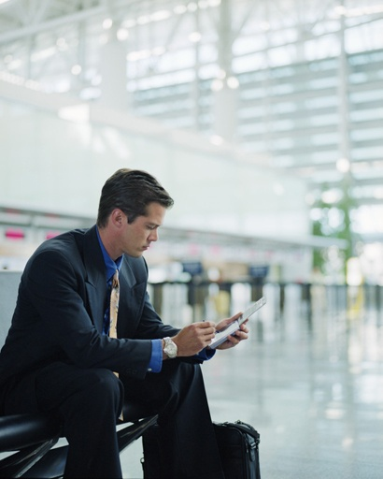
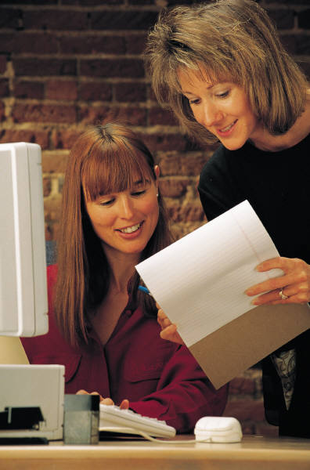
Spyware
hacker
Capture keystrokes
Password
Credit card
Password
Viruses used to delete your files. Now they become spyware and steal your data, passwords, and credit cards.

Slide 15
Stopping a Virus/Trojan Horse
Backup your data!
Never run applications unless you are certain they are safe.
Never open executable attachments sent over the Internet--regardless of who mailed them.
Antivirus software
Scans every file looking for known bad signatures
Needs constant updating
Rarely catches current viruses
Can interfere with other programs
Can be expensive
Can usually remove a known virus

Slide 16

Phishing: Fake Web Sites
E-mail
Really good fake of your bank’s Web site.
Bank account is overdrawn. Please click here to log in.
Sent to hacker
who steals your money.
Username
Password
You are tired and click the link and enter username/password.

Slide 17
Avoiding Phishing Attacks
Never give your login username and password to anyone. Systems people do not need it.
Be extremely cautious about bank sites and avoid clicking any links that are sent by e-mail.
Always double-check the URL of the site and the browser security settings.

Slide 18
Two-step Process often used by Banks
Real bank site
Username
URL
Security indicators
Image or phrase you created earlier
Password:
Password
After checking the URL, security indicators, and the image or phrase you entered when you opened the account, it is safe to enter your password.

Slide 19
Patching Software
Vendor announces patch
Hacker attacks your computer when you go to a Web site
Researchers find bug
time
You should update immediately
Zero-day attack.
Hacker finds bug/hole first.
Everyone is vulnerable.

Slide 20

Unpatched Computer/Known Holes
Researchers and vendors find bugs in programs.
Bugs enable attackers to create files and Web sites that overwrite memory and let them take over a computer. Even with images and PDF files.
Attackers learn about holes and write scripts that automatically search for unpatched computers.
Thousands of people run these scripts against every computer they can find on the Internet.
Someone takes over your computer.
Vendors fix the programs and release updates.
You forget to update your computer.
2008, SFGate, 95% of computers need updates (online)
2011, RSA/Computerworld, 80% of browsers need updates (online)

Slide 21
Update Your Software
O/S: Microsoft (and Apple)
Set security system to auto-update.
But laptops are often turned off.
Microsoft “patch Tuesday” so manually check on Wednesday or Thursday.
Browsers
Some patched with operating system.
Others use Help/About.
Check add-ins: Java, Flash, Acrobat, …
Applications
Check with vendor Web site.
Try Help/About.
Monitor your network usage.
Botnet software and viruses can flood your network.
Slowing down traffic.
Exceeding your Internet data caps.

Slide 22

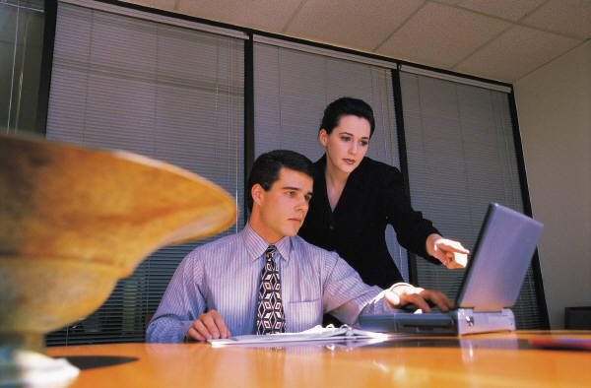
Internet Data Transmission
Eavesdropper
Destination
Intermediate Routers
Start

Slide 23
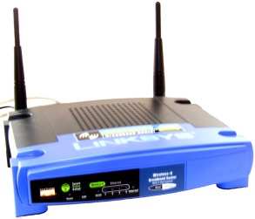


Intercepted Wireless Communications
Hacker installs software to capture all data traffic on the wireless network. (e.g., Firesheep)
Most passwords are encrypted and are safe.
Browser cookies from the server are rarely encrypted and can be captured to impersonate you on your Web service accounts.

Slide 24
Protect Wireless Transmissions
Never use public wireless for anything other than simple Web surfing?
Use virtual private network (VPN) software which encrypts all transmissions from your computer to their server?
Encourage Web sites to encrypt all transmissions?
Most options have drawbacks today (2011).
Warning: Firesheep is extremely easy to use and it is highly likely someone is running it on any public network you use.
Eventually, it is likely that all Internet connections will have to use end-to-end encryption for all communication. (Which is the point of the author of Firesheep.)

Slide 25


Common Web Encryption: Login only
Initial page, encryption keys
Username/password
(encrypted)
Cookie/identifier
(Not encrypted)
Session and additional pages not encrypted. With unencrypted cookie/identifier.
Server
Hijacked session
Intercepted
User
Eavesdropper
hacker

Slide 26
Fundamental Issue: User Identification
Passwords
Dial up service found 30% of people used same word
People choose obvious
Post-It notes
Hints
Don’t use real words
Don’t use personal names
Include non-alphabetic
Change often
Use at least 8 characters
Don’t use the same password everywhere
→ But then you cannot remember the passwords!
Alternatives: Biometrics
Finger/hand print
Voice recognition
Retina/blood vessels
Iris scanner
DNA ?
Password generator cards
Comments
Don’t have to remember
Reasonably accurate
Price is dropping
Nothing is perfect

Slide 27
Bad Passwords
Some hackers have released stolen and cracked password files. Analysis reveals the most common passwords—which are also in a list used by hackers. Do not use these as your password! Example source: Ashlee Vance, “If Your Password Is 123456, Just Make It HackMe,” The New York Times, January 20, 2010.
123456
12345
123456789
password
iloveyou
princess
rockyou
1234567
12345678
abc123
nicole
daniel
babygirl
monkey
jessica
lovely
michael
ashley
654321
qwerty
Iloveu
michelle
111111
0
Tigger
password1
sunshine
chocolate
anthony
Angel
FRIENDS
soccer

Slide 28
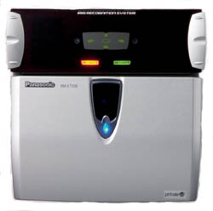
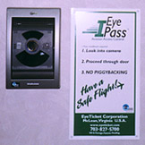
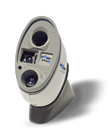
Iris Scan
Panasonic
http://www.eyeticket.com/
eyepass/index.html
http://www.iridiantech.com/
questions/q2/features.html
Algorithm patents by JOHN DAUGMAN 1994
http://www.cl.cam.ac.uk/~jgd1000/

Slide 29
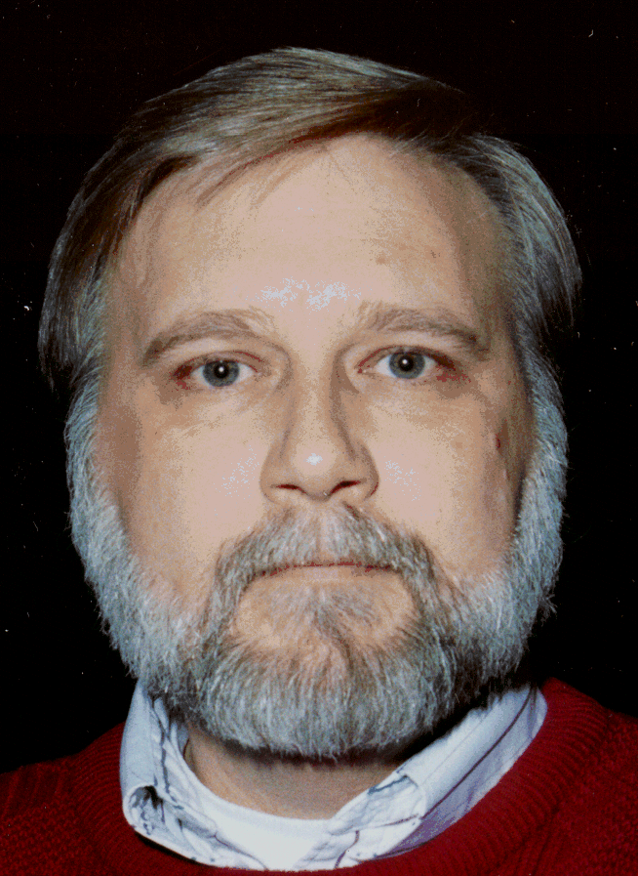
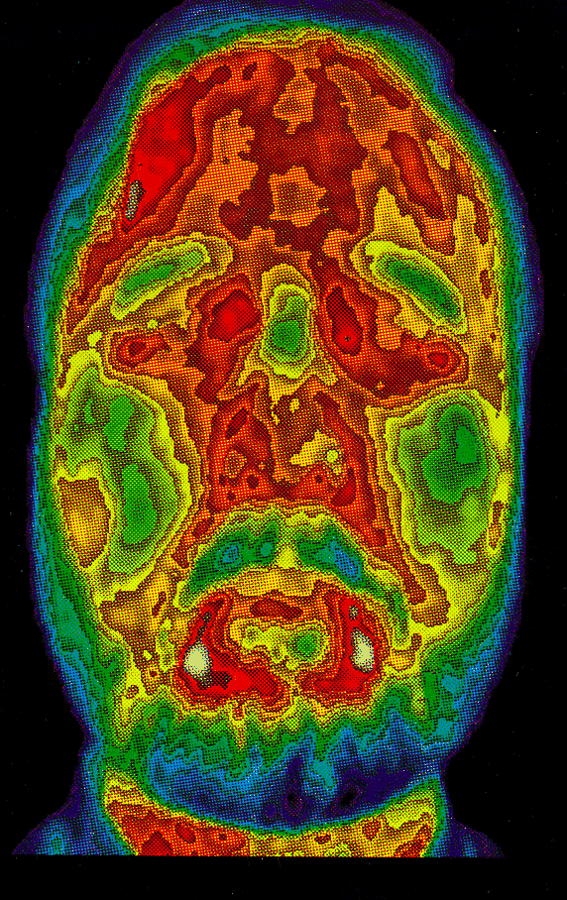
Biometrics: Thermal
Several methods exist to identify a person based on biological characteristics. Common techniques include fingerprint, handprint readers, and retinal scanners. More exotic devices include body shape sensors and this thermal facial reader which uses infrared imaging to identify the user.

Slide 30
Lack of Biometric Standards
Biometrics can be used for local logins.
Which can be used within a company.
But, no standards exist for sharing biometric data or using them on Web sites.
And do you really want every minor Web site to store your biometric fingerprints?

Slide 31
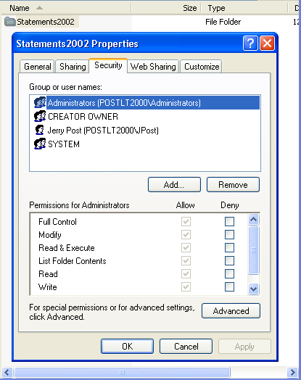
Access Controls: Permissions in Windows
Find the folder or directory in explorer.
Right-click to set properties.
On the Security tab,assign permissions.

Slide 32
Security Controls
Access Control
Ownership of data
Read, Write, Execute, Delete, Change Permission, Take Ownership
Security Monitoring
Access logs
Violations
Lock-outs

Slide 33
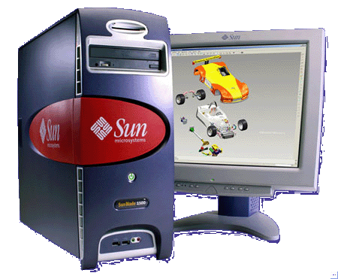
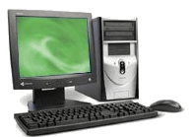

Single sign-on
validate
validate
Database
Web server
Security Server
Kerberos
RADIUS
Request access
User login
Request access

Slide 34


Encryption: Single Key
Plain text
message
Encrypt and decrypt with the same key
How do you get the key safely to the other party?
What if there are many people involved?
Fast encryption and decryption
DES - old and falls to brute force attacks
Triple DES - old but slightly harder to break with brute force.
AES - new standard
AES
Key: 9837362
Encrypted
text
Single key: e.g., AES
Encrypted
text
AES
Key: 9837362
Plain text
message

Slide 35

Encryption: Dual Key
Message
Message
Encrypted
Alice
Bob
Private Key
13
Public Keys
Alice 29
Bob 17
Use
Bob’s
Private key
Private Key
37
Use
Bob’s
Public key
Alice sends message to Bob that only he can read.

Slide 36

Dual Key: Authentication
Message
Transmission
Message
Message+A
Message+B
Alice
Message+A+B
Private Key
13
Bob
Use
Alice’s
Private key
Public Keys
Alice 29
Bob 17
Private Key
37
Use
Bob’s
Private key
Use
Bob’s
Public key
Use
Alice’s
Public key
Alice sends a message to Bob
Her private key guarantees it came from her.
His public key prevents anyone else from reading message.

Slide 37

Certificate Authority
How does Bob know that it is really Alice’s key?
Trust the C.A.
C.A. validate applicants
Public key
Imposter could sign up for a public key.
Need trusted organization.
Several public companies, with no regulation.
Verisign mistakenly issued a certificate to an imposter claiming to work for Microsoft in 2001.
Browser has list of trusted root authorities.
Alice
Public Keys
Alice 29
Bob 17
Eve could impersonate Alice to obtain a digital key and send false messages that seem to come from Alice.
Eve

Slide 38
Encryption Summary
Encryption prevents people from reading or changing data.
Dual-key encryption can be used to digitally sign documents and authenticate users.
Encryption does not solve all problems.
Data can still be deleted.
Hackers might get data while it is unencrypted.
People can lose or withhold keys or passwords.
Brute force can decrypt data with enough processing power.
Difficult if the keys are long enough.
But computers keep getting faster.
Connecting a few million together is massive time reduction.
Quantum computing if developed could crack existing encryption methods.

Slide 39
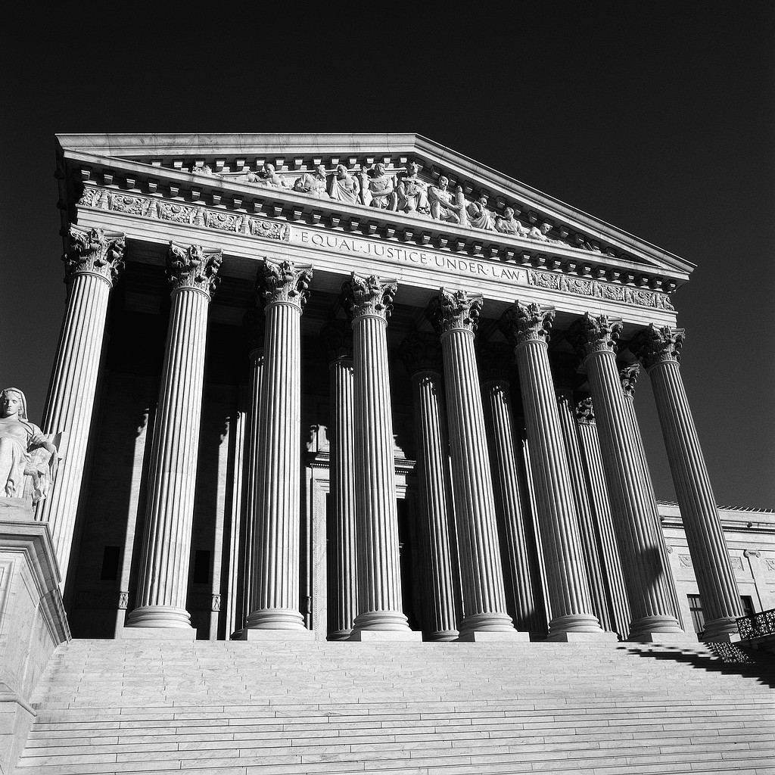

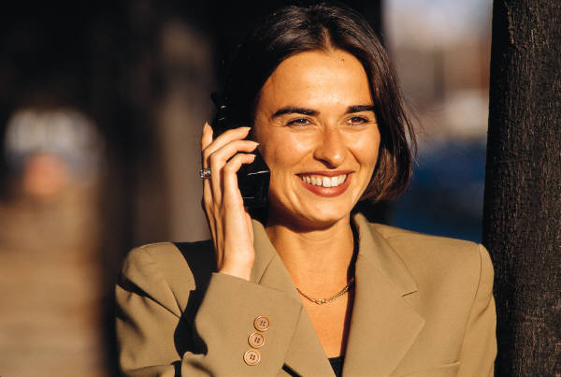
Clipper Chip: Key Escrow
Decrypted conversation
Escrow keys
Judicial or
government office
Intercept
Encrypted conversation
Clipper chip
in phones

Slide 40
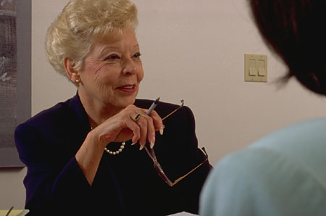
Additional Controls
Audits
Monitoring
Background checks:
http://www.lexisnexis.com/risk
(bought ChoicePoint)
http://www.knowx.com/
(also lexis nexis)
http://www.casebreakers.com/
http://www.publicdata.com/

Slide 41
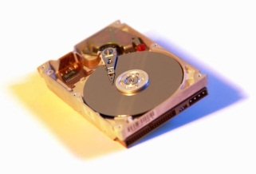
Computer Forensics
Software:
Verify copy.
Tag/identify files.
Scan for key words.
Recover deleted files.
Identify photos.
Attempt to decrypt files.
Time sequence
Browser history
File activity
Logs
Original drive
Exact copy
Write blocker:
Physically prevent data from being altered on the original drive.

Slide 42
Securing E-Commerce Servers
Install and maintain a firewall configuration to protect cardholder data.
Do not use vendor-supplied defaults for passwords.
Protect stored cardholder data.
Encrypt transmission of cardholder data across open, public networks.
Use and regularly update anti-virus software.
Develop and maintain secure systems and applications.
Restrict access to cardholder data by business need to know.
Assign a unique id to each person with computer access.
Restrict physical access to cardholder data.
Track and monitor all access to network resources and cardholder data.
Regularly test security systems and processes.
Maintain a policy that addresses information security.
https://www.pcisecuritystandards.org/

Slide 43
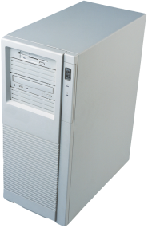




Internet Firewall
Internal company data servers
Firewall router
Keeps local data from going to Web servers.
Company PCs
Firewall router
Examines each packet and discards some types of requests.
Internet

Slide 44
Firewalls: Rules
IP source address
IP destination address
Port source and destination
Protocol (TCP, UDP, ICMP)
Allowed packets
Rules based on packet attributes
Allow: all IP source, Port 80 (Web server)
Disallow: Port 25 (e-mail), all destinations except e-mail server.
…
Internet by default allows almost all traffic.
Firewalls usually configured to block all traffic, and allow only connections to specific servers assigned to individual tasks.

Slide 45
Intrusion Detection System (IDS) Intrusion Prevention System (IPS)
Collect packet info from everywhere
IDS/IPS
Analyze packet data in real time.
Rules to evaluate potential threats.
IPS: Reconfigure firewalls to block IP addresses evaluated as threats.
Company PCs

Slide 46
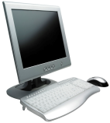





Denial Of Service
Coordinated flood attack.
Targeted server.
Break in.
Flood program.
Zombie PCs at homes, schools, and businesses. Weak security.

Slide 47
Denial of Service Actions
Hard for an individual company to stop DoS
Can add servers and bandwidth.
Use distributed cloud (e.g., Amazon EC2)
But servers and bandwidth cost money
Push ISPs to monitor client computers
At one time, asked them to block some users.
Increasingly, ISPs impose data caps—so users have a financial incentive to keep their computers clean.
Microsoft Windows has anti-spyware tools to remove some of the known big threats.

Slide 48
Cloud Computing and Security
Cloud providers can afford to hire security experts.
Distributed servers and databases provide real-time continuous backup.
Web-based applications might need increased use of encryption.
But, if you want ultimate security, you would have to run your own cloud.

Slide 49
Privacy
Tradeoff between security and privacy
Security requires the ability to track many activities and users.
People want to be secure but they also do not want every company (or government agency) prying into their lives
Businesses have an obligation to keep data confidential
More details in Chapter 14

Slide 50
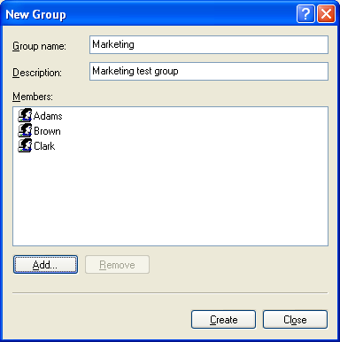
Technology Toolbox: Security Permissions
If Windows XP, Tools/Folder Options, Advanced, uncheck “Use simple file sharing”
Create groups and users (or pull from network definitions when available)
Start menu/All Programs/Administrative Tools/Computer Management or Start/Run: compmgmt.msc /s
Add users and groups
Find folder, right-click, Sharing and Security, Permissions, remove “Everyone,” Add the new group with Read permission

Slide 51
Quick Quiz: Encryption
1. Why would a business want to use encryption?
2. When would it be useful to set up dual-key encryption for e-mail?
3. In a typical company, which drives should use drive-level encryption?

